Slide 1
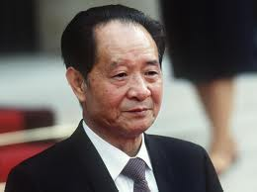
China’s Forgotten Hero Hu Yaobang
Bruce Gilley, Portland State University

Slide 2
PART 1: Hu in life

Slide 3
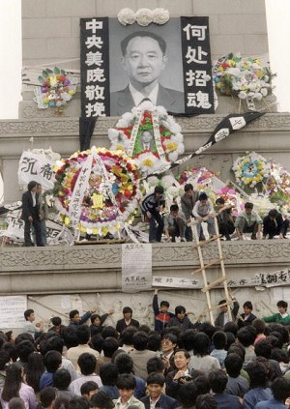
Hu’s 14 Heroic Years
b. 1915
1952-66: First Secretary of Communist Youth League
1975: Head of Chinese Academy of Sciences Organization Department
1977: Head of CCP Organization Department
1978: CCP chairman (then general-secretary)
1986: Removed as CCP general secretary for tolerating “bourgeois liberalization”
1989: Died during politburo meeting – PBSC-level memorial -- Tiananmen movement begins

Slide 4
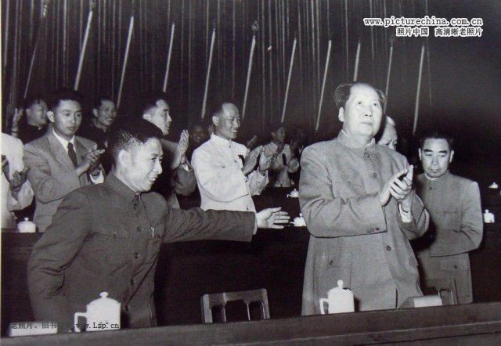
Burying Maoism
1978-1982: Rehabilitating 3.8 million “rightists”
1979: Theory Conference critizing Mao
“The current problem is that we have to do ‘whatever’ Mao said…I’d rather go home and take care of my family.”

Slide 5
Reconciling Tibet
Hu’s Six Points
Real political autonomy
Tax relief
Private economy
De-industrialization
Tibetan science and education
Han cadre repatriation
Also
Appointed Tibetan-speaking party secretary
Return of Dalai Lama
1980, Potala Palace, Lhasa
“We feel that our party has let the Tibetan people down. We feel very bad!...We have worked nearly thirty years, but the life of the Tibetan people has not been notably improved. Are we not to blame?”

Slide 6
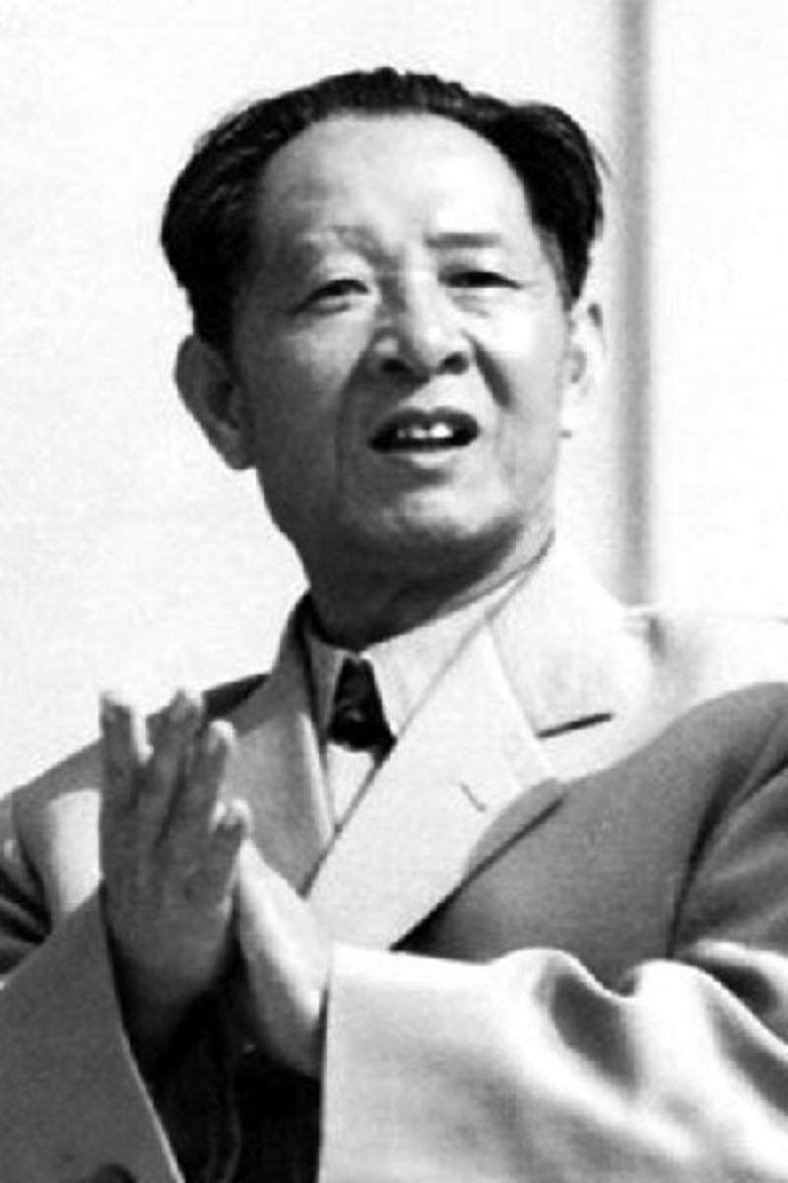
Promoting Democracy
1978: China Youth Daily relaunch and articles on democracy
1979: Democracy Wall (Liu Binyan, Wang Ruowang, Wei Jingsheng)
1984: Chinese Writers Association open elections
1986: Student protests and toleration (Fang Lizhi)
1987: 13th Party Congress proposes legal limits on party and separation of party and government

Slide 7
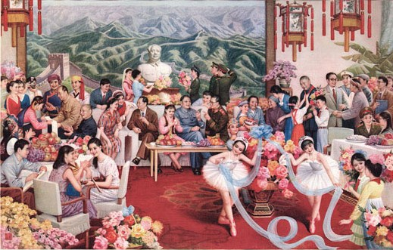
Gao Qikui (郜起奎), Carry forward the revolutionary cause and forge ahead into the future (继往开来), 1986

Slide 8
Part 2: hu in death

Slide 9
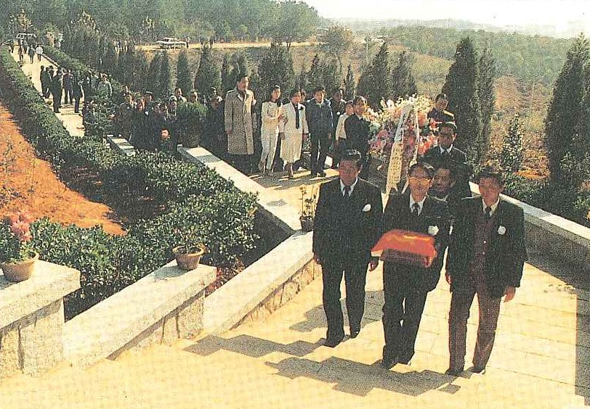
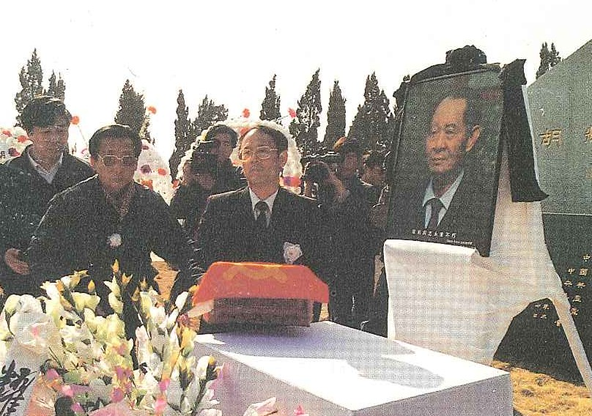
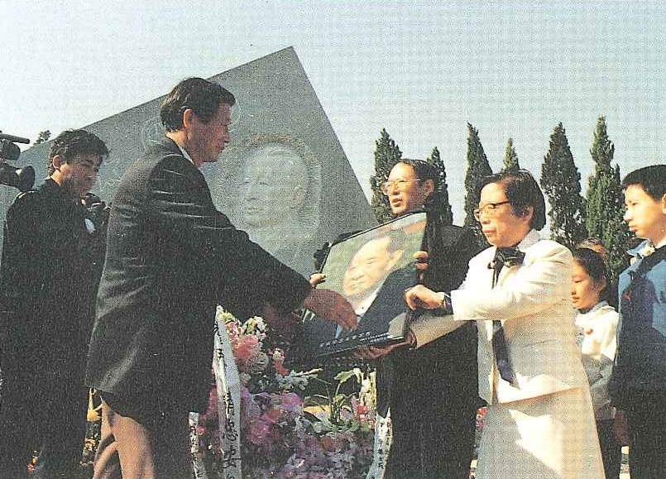
Avoiding the Rogues of Babaoshan
1990: Interment at mausoluem at China Youth League City, Jiangxi province

Slide 10
The Long Silence
1990: 70 Days: From Hu Yaobang’s Death to Zhao Ziyang’s Dismissal (70天大事记: 胡耀邦病逝到赵紫阳解职) (China Youth League Press)
1996: Wu Jiang, The Ten Year Road: My Days With Hu Yaobang (十年的路:和胡耀邦相處的日子)(Hong Kong)
1998: Hu Jintao as Central Party School president praises Hu Yaobang’s role in reversing Maoism

Slide 11
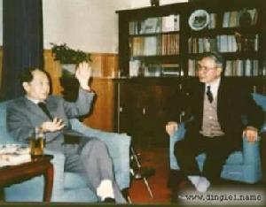
The Role of Zhang Liqun (张黎群) (b.1918-d. 2003)
1999: Zhang Liqun et al., Missing Yaobang (怀念耀邦), 4 vols., (Hong Kong)

Slide 12
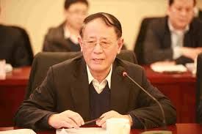
The Role of Hu Deping (胡德平)

Slide 13
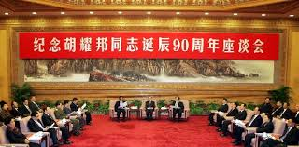
The Sudden Return
2005: CCP Forum Commemorating the 90th Anniversary of Hu Yaobang’s Birth, Great Hall of the People, Beijing

Slide 14
Wound Literature
2005: Zhang Liqun et. al., Hu Yaobang (3 vols. ) (Beijing: People’s Publishing House)
2005: Man Mei, Endless Missing -- Recalling My Father Hu Yaobang (Beijing Publishing House)
2010: Wen Jiabao, “Recalling Yaobang on Returning to Xingyi” (再回兴义忆耀邦), People’s Daily
2011: Hu Deping, Why China Should Reform: Remembering My Father Hu Yaobang (中國為甚麼要改革－回憶父親胡耀邦) (Beijing: People’s Publishing House)

Slide 15
Scholarly Literature
Scholarly articles on Hu Yaobang published in China

Slide 16
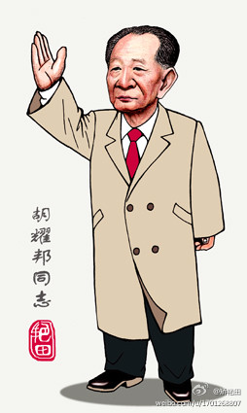
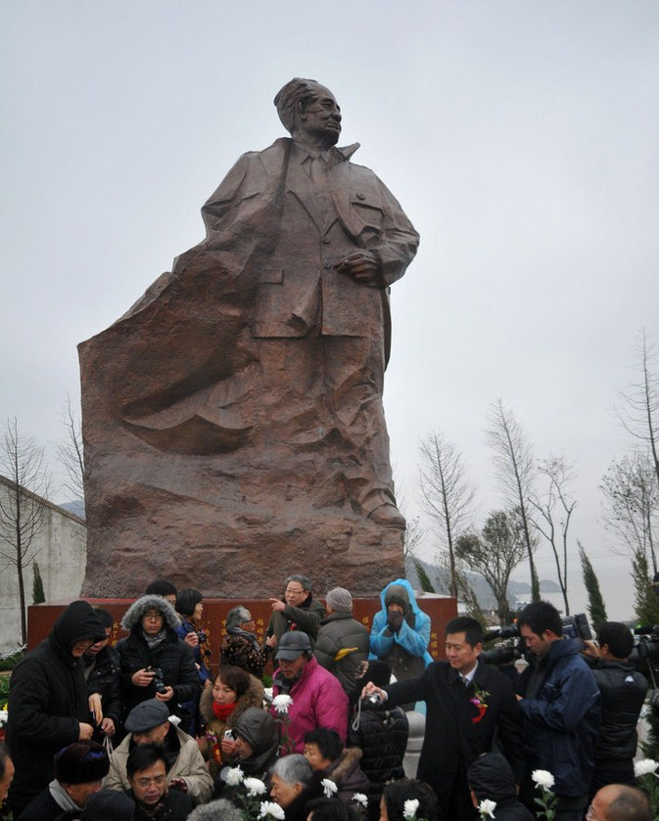
Rebuilding the Hero
Dachen Island, Taizhou City, Zhejiang province (Unveiled 2013)
Jiao Yantian (矫艳田), 2013

Slide 17
Struggles for the Aura
2012: Xi Jinping visits Hu Deping before becoming CCP General Secretary
2013: Official commemorations of 24th anniversary of Hu Yaobang’s death (video)

Slide 18
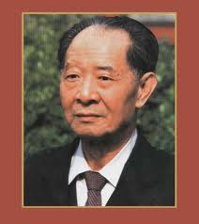
Conclusions
The aura without the angel?

